Slide 1


Employee Salary Analysis
Transform raw data into actionable insights with Python. Discover powerful tools like Pandas, NumPy, and Sklearn. Achieve a data-driven understanding of your workforce.
TEAM MEMBERS :
KUMAR KASHYAP (202410116100106)
KUNAL SINGH (202410116100109)
GAURAV VISHWAKARMA (202410116100076)
LAVISH NEHRA (202410116100111)
FACULTY :
MR APOORV JAIN
ASSISTANT PROFESSOR
Notes:
1

Slide 2

Introduction
Salary analysis is vital in HR and financial planning. Fair compensation ensures employee satisfaction. It also aids in effective budget decisions.
Our objective is to build a predictive model using Linear Regression. This will enhance decision-making processes in HR.
The importance of salary analysis
Attracting top talent
Reducing turnover
Staying competitive

Slide 3




Problem Statement & Objectives
Manual salary estimation is prone to bias and inaccuracies. Subjective assessments can lead to unfair compensation.
Our model aims to predict salary based on experience, age, and gender. Additionally, it provides real-time user predictions.
Automated predictions
Real-time analysis
Eliminate bias and subjective assessments in salary estimation, ensuring fair compensation decisions.
Enable HR professionals to quickly generate salary predictions based on user-defined parameters.
Data-driven insights
Provide actionable insights and trends in salary data, supporting strategic planning.

Slide 4
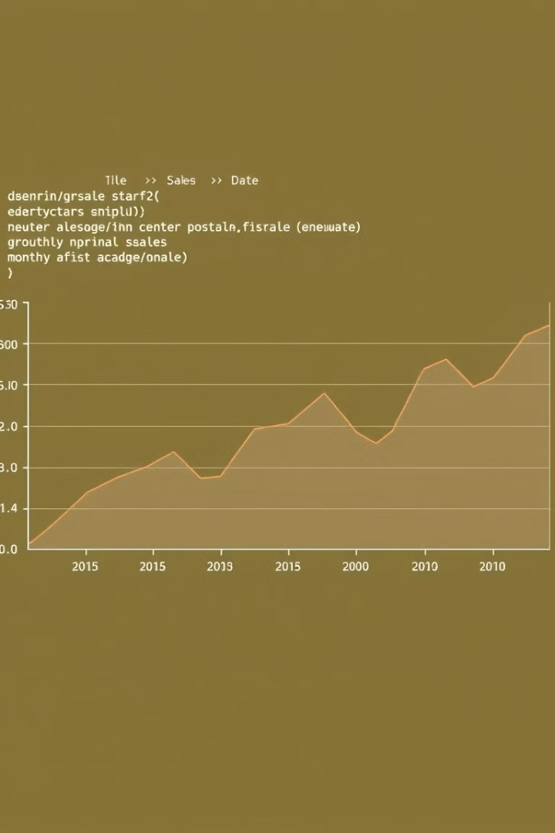



Python's Powerful Libraries
Pandas
NumPy
Sklearn
For data manipulation and analysis.
For numerical computations and statistics.
For machine learning models.
These libraries make salary analysis efficient and insightful.
Notes:
4

Slide 5
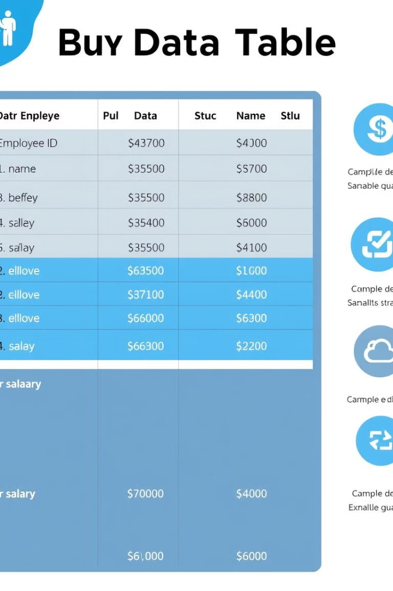




Dataset Overview
We used the Employee_Salary_Dataset.csv. Key features include Experience, Age, Gender, and Salary (Target). Data cleaning involved removing missing values. We also removed the irrelevant ID column to clean the data.
Experience Years
Age
Gender
Years of professional work experience
Employee age in years
Employee gender
Salary (Target)
Annual salary in local currency

Slide 6







Methodology
Our approach follows a step-by-step process. It starts with data collection and preprocessing. Feature selection and train-test split are crucial steps. The model is then trained, evaluated, and used for predictions.
Data Collection
Gather relevant employee data
Preprocessing
Clean and format data for modeling
Feature Selection
Identify key predictive features
Train-Test Split
Divide data for training and validation
Model Training
Train the Linear Regression model
Evaluation
Assess model performance
Prediction
Predict salaries using the trained model

Slide 7
Algorithm Used: Linear Regression
Linear Regression predicts salary using a linear equation. Salary = b0 + b1_Experience + b2_Age + b3*Gender. It was chosen for simplicity and interpretability.
Evaluation metrics include MAE, MSE, and R-squared. These metrics help us assess model accuracy.
MAE
1
Mean Absolute Error
MSE
2
Mean Squared Error
R² Score
3
R-squared Score

Slide 8

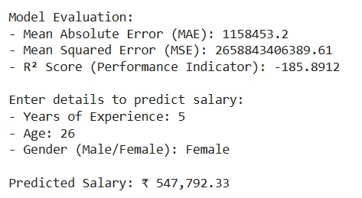
Output & Prediction
Our model evaluation results show the effectiveness of Linear Regression. For example: MAE: ₹2000, MSE: ₹1500000, R² Score: 0.89.
With user input like 5 years of experience, 28 years old, and male, the predicted salary is ₹50,000.
₹2000
₹1.5M
MAE
MSE
Indicates the average magnitude of errors between predicted and actual salary values.
Represents the average of the squares of the errors; sensitive to outliers.
0.89
R² Score
Measures the proportion of variance in the salary that can be predicted from the independent variables.

Slide 9
THANK YOU
Notes:
8

